Slide 1
MANA 5344-003 Evidence-Based Management Project Presentation
Tejesh Varma Rudraraju

Slide 2
INTRODUCTION
We are a MAV Consulting firm that provides management and technology consulting services for the world’s leading life sciences, consumer products, and retail companies. We focus on delivering brilliant client service combined with our sought-after consulting talent differentiates us from other consulting firms. We leverage decades of industry experience and client commitment to deliver solutions that work for your business and your people, no matter the challenge. we offer a broad set of customized consulting services created by our team of exceptional industry leaders. Everything we do is designed to deliver business value. Currently we are being approached by ABC auctions which is a well-established wholesale vehicle auction company to analyze the data to see whether employee attitudes are related to employee behaviors and auction performance. We were asked to run few models and present a report of findings at ABC’s annual meeting and make a set of recommendations on investments that could be beneficial towards HR practices.

Slide 3
BACKGROUND
ABC Auctions began as a wholesale vehicle auction more than 50 years ago. Nowadays it employs 20,000 people in 100 locations around the world. At over 75 auctions in North America and 11,000 full-time employees, they manage half a million cars. They garner a billion dollars in revenue each year and are frequented by over 75,000 car dealers each month.
ABC's original auction in Cherry Hill, New Jersey, began in 1952 and grew to become the largest wholesale auto auction in the United States. ABC began rapidly expanding in the 1980s, primarily through the acquisition of existing auto actions. Independent wholesale auto auctions were available in most major cities, and ABC planned to expand by purchasing out original owners.
When ABC took over an auction, it frequently retained key managers and adhered to old business practices. Individual auctions were given a lot of incentive by corporate headquarters in New Jersey if they were profitable. The auctions are all operate as separate businesses, with considerable performance incentives for the senior managers. As a result, there was a significant amount of variation in HR procedures and management approaches.
The corporate human resources manager initiated a major action plan to drive some consistency in auction practices and share best practices. The effort began with research into current HR practices and auction performance.

Slide 4
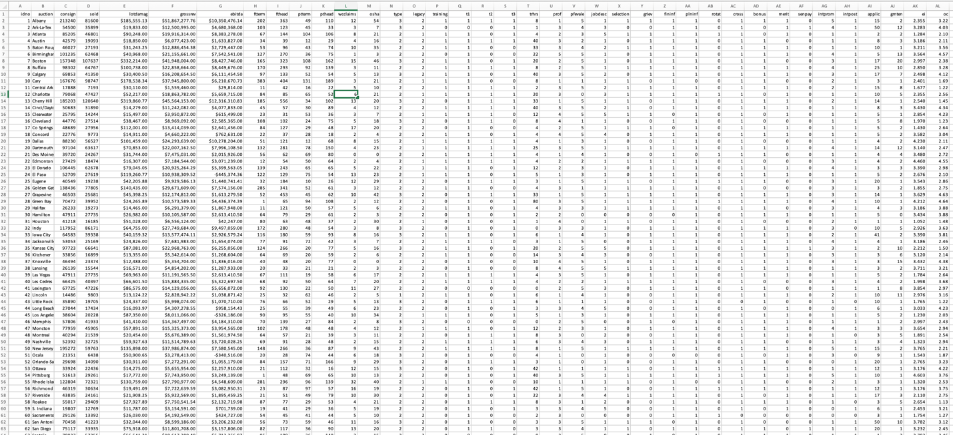
DATA DESCRIPTION
The data set consist of 76 rows and 38 columns.

Slide 5
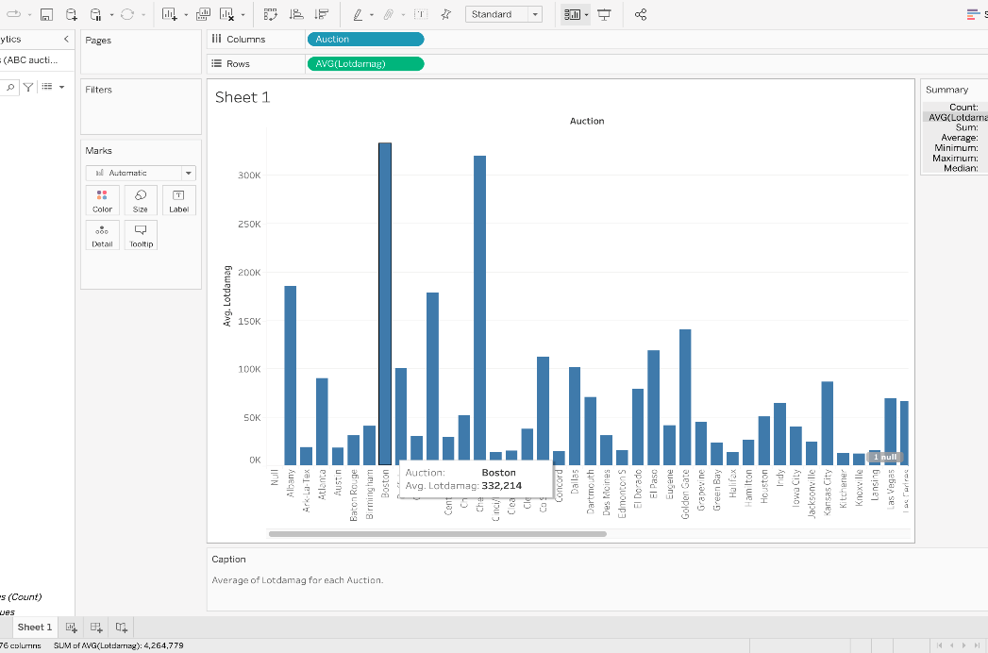
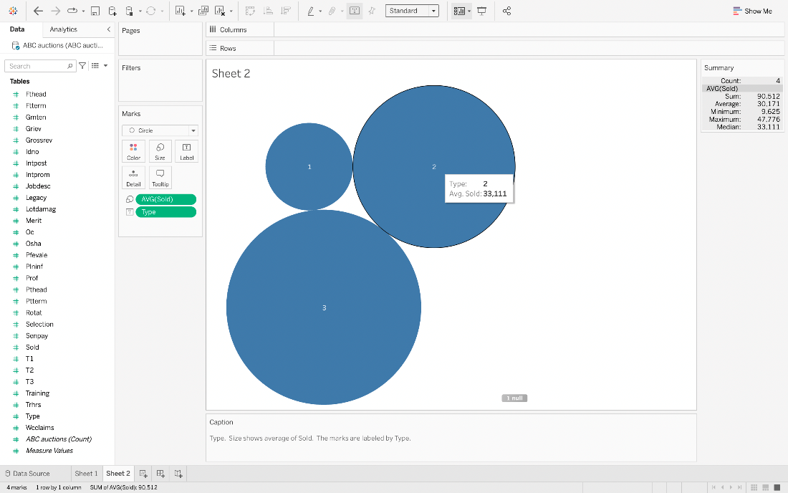
DATA VISUALIZATION
We utilized the Tableau tool to create graphs that visualize data. After reviewing the data, we used a bar graph to compare the attributes like average Lot damage each year and the auction unit's name.
As for 332,214 lot damages annually, Boston has the most, as shown in the graph above, while Saskatoon has the fewest (3,824).
We used two attributes in the graph above, sold (the total number of cars sold) and auction type, which includes three types:
1 = Public
2 = Dealer
3 = Both public and dealer
In the graph to the right, type 3—which includes both public and dealer sales—has the most cars sold (47,776), however when compared to types 1 (public) and 2 (dealer), dealer sales are higher (33,111) than public sales.

Slide 6
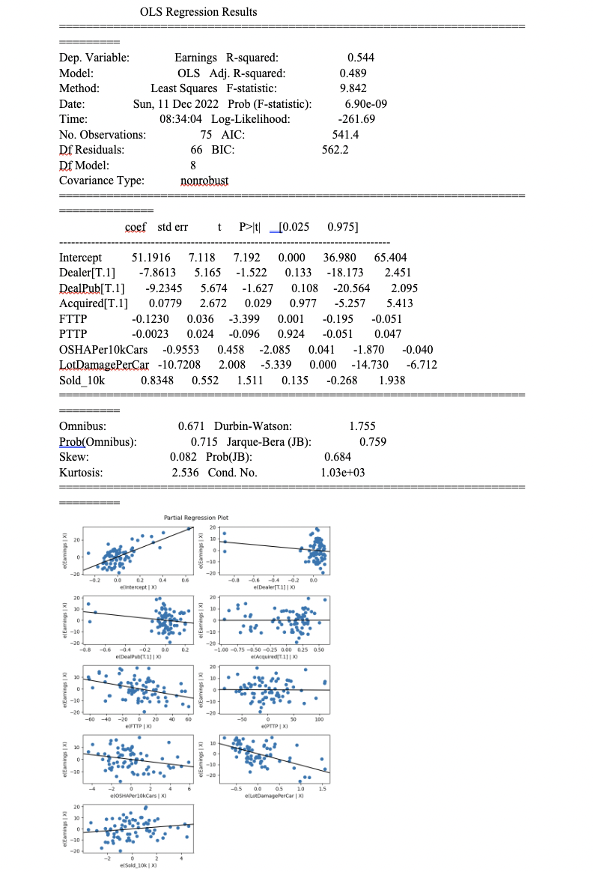
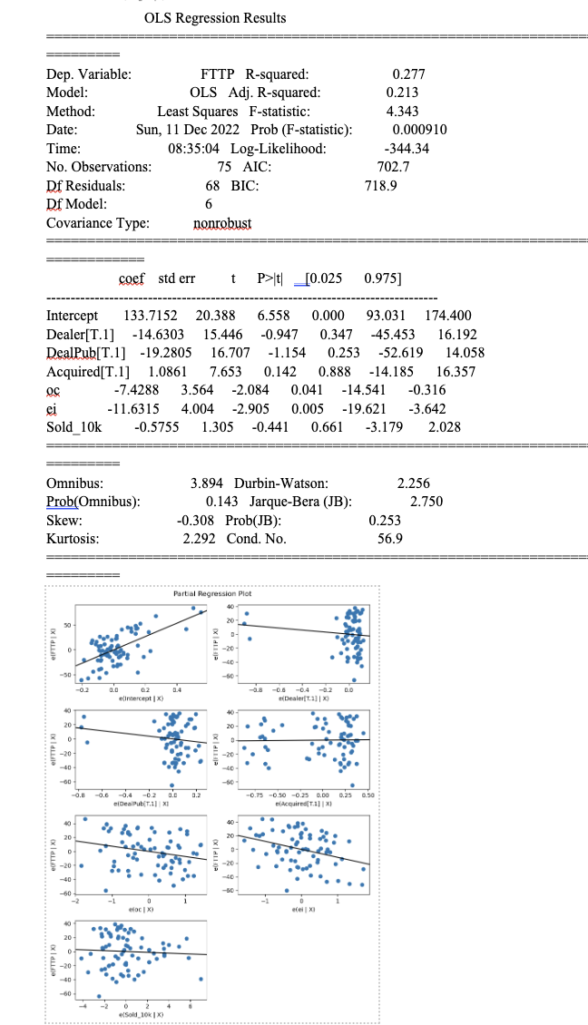
OLS Regression
PROFIT Model
FT Turn Model

Slide 7
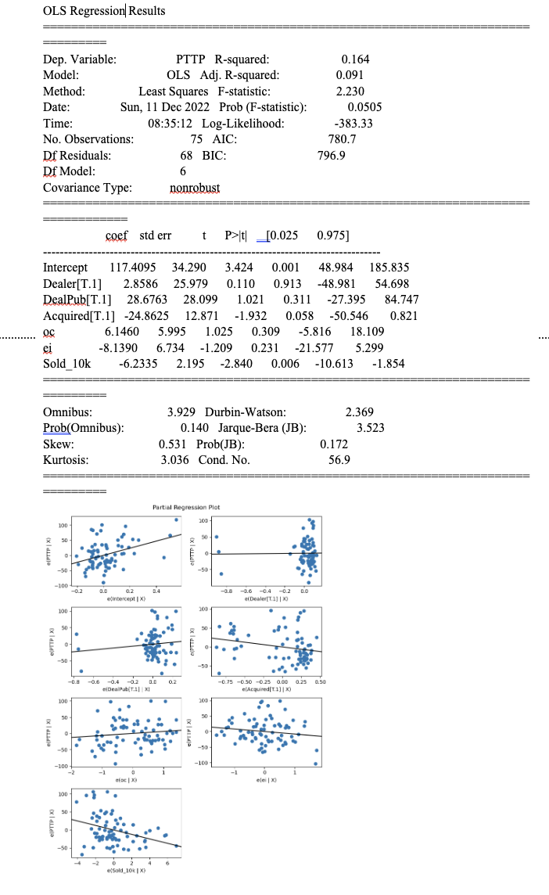
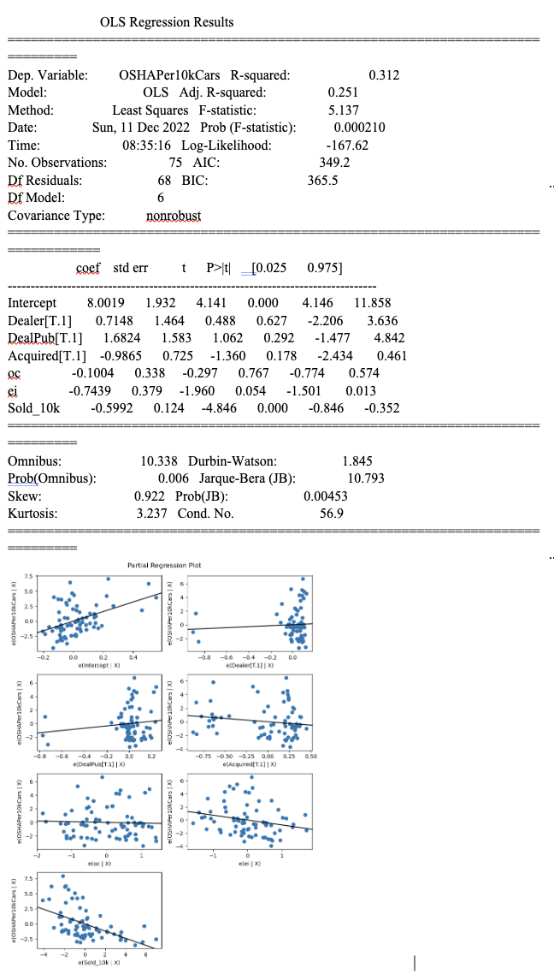
PT Turn Model
OSHA Model

Slide 8
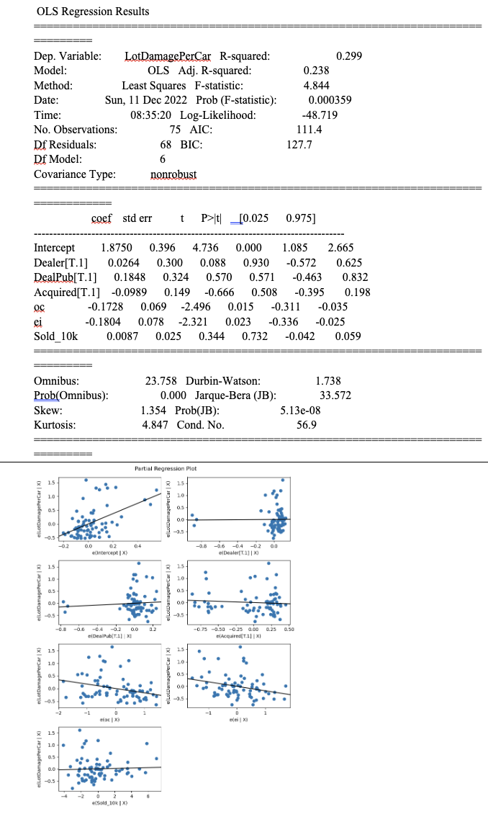
Damage model

Slide 9
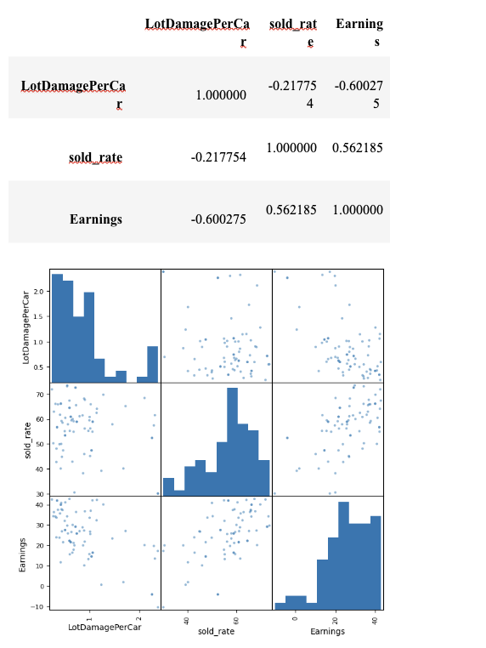
Correlation
The Correlations among average lot damage per car consigned, percentage of cars sold, and earnings as a percentage of gross revenue.

Slide 10
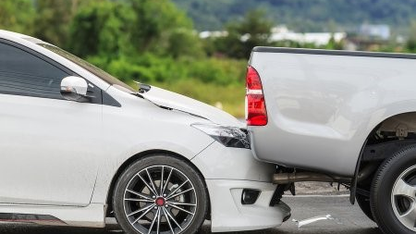
ANALYSIS
Data furnished by ABC Auctions management included aggregate human resources, operational, and financial metrics for all 75 auctions in North America. These data from the company were supplemented by an anonymous survey of all front-line employees measuring their attitudes toward the company and their jobs. Each response was then included in a score describing either organizational commitment or employee involvement, and the scores by employees were then averaged for each location.
Location profitability was regressed on four operational metrics, revealing statistically significant relationships with three: lot damage, number of OSHA incidents, and full-time turnover. Each one-unit increase in average lot damage was associated with a 10.72-unit decrease in profit, each one-unit increase in OSHA accidents was associated with a 0.955-unit decrease, and each one-unit increase in full-time turnover was associated with a 0.123-unit decrease.
Concerning lot damage’s strong negative effect on profits, we found support for the intuitive explanation that a damaged vehicle would be less marketable than a clean one. In the ratio of car sales to total car consignments, 22 percent of the variation was related to lot damage and 56 percent correlated with profits. Overall, 60 percent of the variation in profits was related to lot damage.

Slide 11
We regressed the average lot damage per car consigned on both attitudes and found them strong predictors. A one-unit increase in organizational commitment was associated with a 0.173-unit decrease in lot damage, and a one-unit increase in employee involvement was associated with a 0.18-unit decrease.
Average OSHA incidents per 10,000 vehicles decreased by 0.74 units for each one-unit increase in employee involvement (concerning tangible job training and quality of work), but we found no statistically significant relationship to organizational commitment (focused more on the employee’s general fondness for the company).
Average full-time turnover rates decreased by 7.43 units for each one-unit increase in organizational commitment and by 11.63 units for each one-unit increase in employee involvement.

Slide 12
Attitudes
We correlated the attitudes reflected in the employee surveys against the human resources practices identified in the management surveys. The strongest associations for employee involvement were with performance evaluations, followed by internal job postings, followed by training hours (all positive). Organizational commitment was associated most strongly with internal job postings, followed by performance evaluations, followed by formal grievance procedures, then merit raises (all positive associations). The greatest expected payoff is from implementing consistent high-quality practices around performance evaluations.

Slide 13
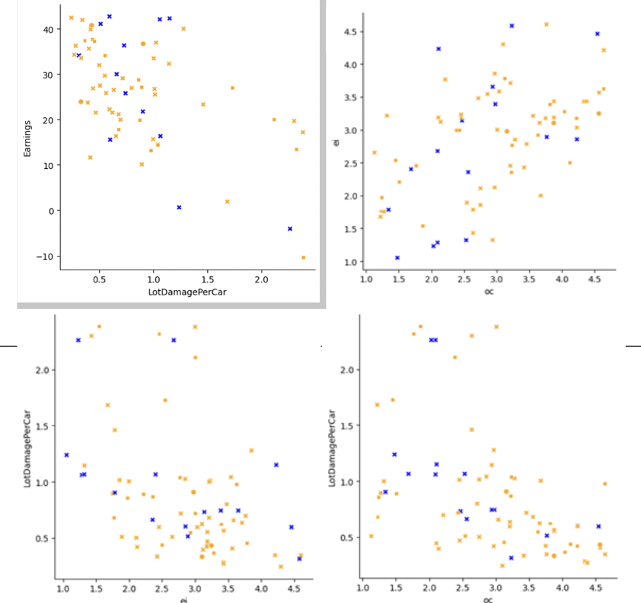
Method & Type of analysis that conducted
Linkage analysis was performed with linear regressions controlling for auction type (public only, dealer only, or open to both), legacy vs acquired auctions, and the quantity of vehicles sold annually.
Legacy auctions (in blue) were far less numerous than the independent auctions acquired by ABC (in orange), but they exhibited the same patterns: high earnings were associated with low lot damage, organizational commitment and employee involvement attitudes had a strong positive relationship, and higher scores on both attitudes were associated with lower lot damage.

Slide 14
Discussion of limitations
Our model is limited by the small sample size (n=75) and does not control for geographic or demographic differences among the various locations. Three of the six location categories are too small to make any statistical conclusions about them (n=0, n=0, and n=3).
Our estimates may be inflated or muted by the inclusion of outliers, namely, the most extreme offenders in average lot damage or OSHA incidents.

Slide 15
Recommendations
Rationalizations on why an organization should or shouldn't adopt the practices
Organization should:
The company should believe that using ABC Auctions is the greatest approach to conduct business while moving items while also adding value.
Should be done the following Outside Sales, Sales Floors, and Vehicle Sales are the three categories that ABC Auctions uses.
While each of these three divisions should function independently of the others, they all provide the same high-quality services and individualized attention.
Our skilled advertising team should use websites, pamphlets, emails, SMS messages, newspaper ads, and other media in their advertising campaigns.
Since auctions lose money when the vehicles on their lot are damaged, which occurs more frequently when EI and OC attitudes are low, we want the client to utilize the HR practices that are most closely tied to this.
Organization should not:
ABC Auctions is aware of the material value and should not do any personal significance that you could attach to the items that have been committed to us.
ABC Auctions should not be aware of the personal as well as economic worth.

